Slide 1
XNOR-NET分享
报 告 人：马春杰

Slide 2

1
Introduction and Related Work
2
Binary Convolutional Neural Network
3
Experiments
4
Conclusion

Slide 3
1
Introduction and Related Work
2
Binary Convolutional Neural Network
3
Experiments
4
Conclusion

Slide 4


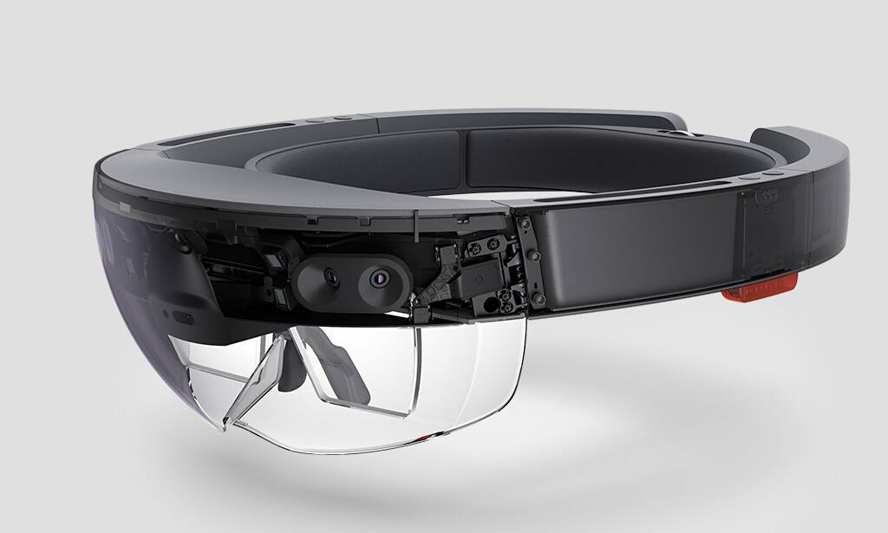
1 Introduction and Related Work
1.1 Introduction
Interesting advancements have been happening in
virtual reality
augmented reality
smart wearable devices

Slide 5
1 Introduction and Related Work
1.1 Introduction
AlexNet has 61M parameters
This models quickly overtax the limited storage, battery power, and compute capabilities of smaller devices like cell phones.
Two Approximations
Binary-Weight-Networks（BWN）
XNOR-Networks

Slide 6
1 Introduction and Related Work
1.1 Introduction
Binary-Weight-Networks
Memory Saving : ~32x
Operations used in Convolution : + -
Time Saving on CPU : ~2x

Slide 7
1 Introduction and Related Work
1.1 Introduction
XNOR-Networks
Memory Saving : ~32x
Operations used in Convolution : XNOR bitcount
Time Saving on CPU : ~58x

Slide 8
1 Introduction and Related Work
1.1 Introduction
It outperforms the state-of-the-art network binarization method by a large margin (16.3%) on top-1 image classification in the ImageNet challenge ILSVRC2012.
A new way of binarizing the weight values in convolutional neural networks.
XNOR-Nets, a deep neural network model with binary weights and binary inputs

Slide 9
1 Introduction and Related Work
1.2 Related Work
Shallow networks
Compressing pre-trained deep networks
Designing compact layers
Quantizing parameters
Network binarization

Slide 10
1 Introduction and Related Work
1.2 Related Work
1.2.1 Shallow networks
A network with a large enough single hidden layer of sigmoid units can approximate any decision boundary.
Training a state-of-the-art deep model
Training a shallow model to mimic it[3]
[3] Approximation by superpositions of a sigmoidal function

Slide 11
1 Introduction and Related Work
1.2 Related Work
1.2.2 Compressing pre-trained deep networks
It can reduces the size of the network at inference time.
Hessian of the loss function. (an order of magnitude)
Reduce the number of activations
Deep compression
HashedNets

Slide 12
1 Introduction and Related Work
1.2 Related Work
1.2.3 Designing compact layers
Decomposing 3 x 3 convolutions with two 1 x 1.
Replacing 3 x 3 convolutions with 1 x 1 convolutions(~50x)
This article use the full network (not the compact version) but with binary parameters

Slide 13
1 Introduction and Related Work
1.2 Related Work
1.2.4 Quantizing parameters
Vector quantization techniques, decreases the top-1 accuracy on ILSVRC2012 by less than %10.
A provably polynomial time algorithm for training a sparse networks with +1/0/-1 weights.
Convert some of the remaining multiplications into binary shifts.
In this article , only 1 and -1.[0]
[0] Provable bounds for learning some deep representations

Slide 14
1 Introduction and Related Work
1.2 Related Work
1.2.5 Network binarization
The performance of highly quantized networks were believed to be very poor.
variational Bayesian approach[1]
[1] Expectation backpropagation: parameter-free training of multilayer neural networks with continuous or discrete weights

Slide 15
1
Introduction and Related Work
2
Binary Convolutional Neural Network
3
Experiments
4
Conclusion

Slide 16



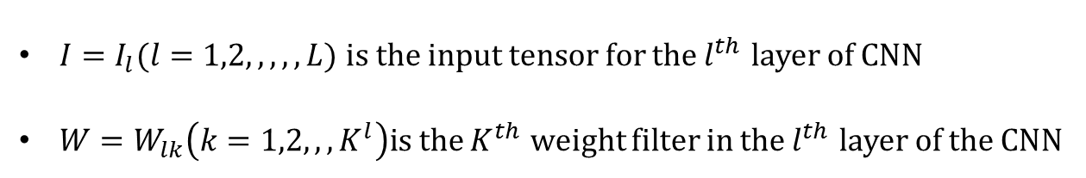

2 Binary Convolutional Neural Network
L-layer CNN architecture with a triplet $(I,W,∗)$
$I=I_{l}(l=1,2,,,,,L)$ is the input tensor for the $l^{th}$ layer of CNN
$W=W_{lk}\left(k=1,2,,,K^{l}\right)\text{is} \text{the}$ $K^{th}$ weight filter in the $l^{th}$ layer of the CNN
$K^{l}$is the number of weight filters in the $l^{th}$
* represents a convolutional operation with I and W as its operands
$$I∈R^{c×w_{in}×h_{in}}$$
$$W∈R^{c×w×h}$$
$$w≤w_{in} , h≤h_{in}$$
Binary-weights-Networks
XNOR-Networks

Slide 17

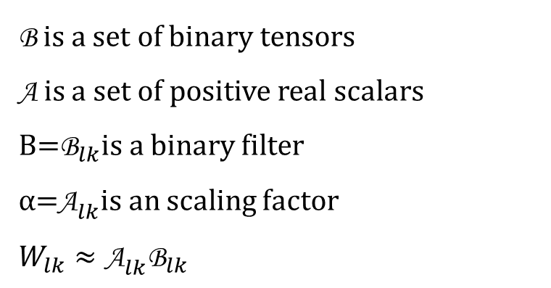


2 Binary Convolutional Neural Network
2.1 Binary-Weight-Networks
2.1.1 Estimating binary weights
$$I∗W≈(I⊕B)α$$
⊕ indicates the convolution with additions and subtractions
$$B∈{\left\{+1,−1\right\}}^{C×W×h}$$
$$α∈R^{+}$$
B is a set of binary tensors
A is a set of positive real scalars
${\text{B}\text{=}\text{B}}_{lk}$is a binary filter
${α\text{=}\text{A}}_{lk}$is an scaling factor
$$W_{lk}≈{\text{A}}_{lk}{\text{B}}_{lk}$$
<I,B,A, ⊕>

Slide 18








2 Binary Convolutional Neural Network
2.1 Binary-Weight-Networks
2.1.1 Estimating binary weights
$$W≈αB$$
$$J\left(B,α\right)={\left\|W−αB\right\|}^{2}$$
$$α^{∗},B^{∗}={argmin \atop α,B}J(B,α)$$
$$J\left(B,α\right)=α^{2}n−2αW^{T}B+c$$
$J\left(B,α\right)=α^{2}B^{T}B−2αW^{T}B+$ $W^{T}W$
$$B^{∗}={argmin \atop B}\left\{W^{T}B\right\} s.t.$$
$$B∈{\{+1,−1\}}^{2}$$
$$B_{i}=+1 if W_{i}≥0 and B_{i}=−1 if W_{i}<0$$
$$B^{∗}=sign(W)$$

Slide 19
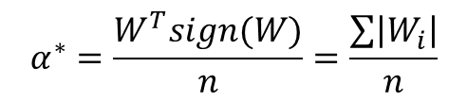

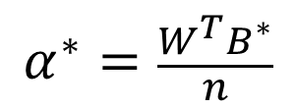
2 Binary Convolutional Neural Network
2.1 Binary-Weight-Networks
2.1.1 Estimating binary weights
$$α^{∗}=\frac{W^{T}B^{∗}}{n}$$
By replacing ${ B}^{∗}$ with sign(W)
$$α^{∗}=\frac{W^{T}sign(W)}{n}=\frac{\sum{\left|W_{i}\right|}}{n}$$

Slide 20
2 Binary Convolutional Neural Network
2.1 Binary-Weight-Networks
2.1.2 Training Binary-Weights-Networks
Each iteration of training a CNN involves three steps：
forward pass
backward pass
parameters update
forward pass
Binarize the weights
backward pass
Use the high precision weights：
parameters update

Slide 21
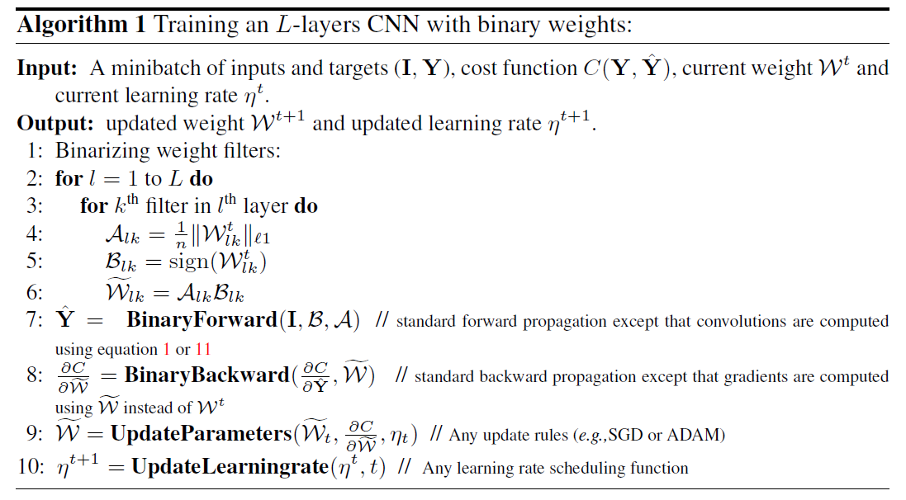

2 Binary Convolutional Neural Network
2.1 Binary-Weight-Networks
$$I∗W≈(I⊕B)α$$

Slide 22
2 Binary Convolutional Neural Network
2.2 XNOR-Networks
binarize both weigths and inputs
INPUT A | 1 0 1 0
INPUT B | 1 1 0 0
OUTPUT | 1 0 0 1
XNOR
A convolution consist of repeating a shift operation and a dot product.
Dot product can be implemented by XNOR-Bitcounting operations [2]
[2] Binarynet: Training deep neural networks with weights and activations constrained to +1 or -1.

Slide 23
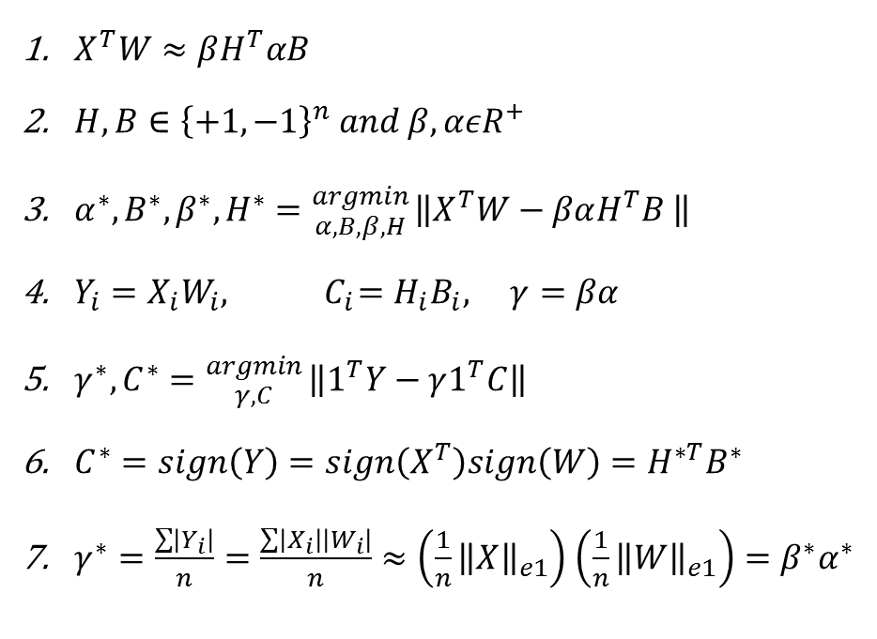
2 Binary Convolutional Neural Network
2.2 XNOR-Networks
2.2.1 Binary dot product
$X^{T}W≈βH^{T}αB$
$H,B∈{\left\{+1,−1\right\}}^{n} and β,αεR^{+}$
$α^{∗},B^{∗},β^{∗},H^{∗}={argmin \atop α,B,β,H}\left\|X^{T}W−βαH^{T}B \right\|$
$Y_{i}=X_{i}W_{i},{ C}_{i}=H_{i}B_{i}, γ=βα$
$γ^{∗},C^{∗}={argmin \atop γ,C}\left\|1^{T}Y−γ1^{T}C\right\|$
$C^{∗}=sign\left(Y\right)=sign\left(X^{T}\right)sign\left(W\right)=H^{∗T}B^{∗}$
$γ^{∗}=\frac{\sum{\left|Y_{i}\right|}}{n}=\frac{\sum{\left|X_{i}\right|\left|W_{i}\right|}}{n}≈\left(\frac{1}{n}{\left\|X\right\|}_{e1}\right)$ $\left(\frac{1}{n}{\left\|W\right\|}_{e1}\right)=β^{∗}α^{∗}$

Slide 24
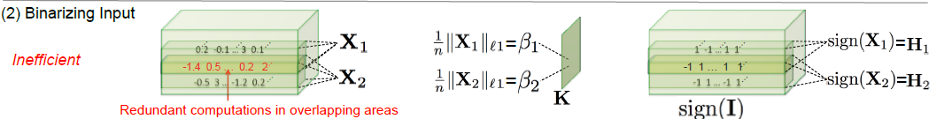



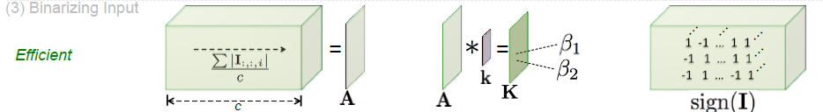
2 Binary Convolutional Neural Network
2.2 XNOR-Networks
2.2.2 Binary Convolution

Slide 25
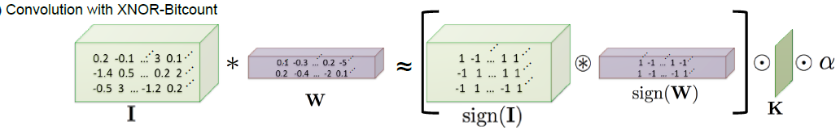
2 Binary Convolutional Neural Network
2.2 XNOR-Networks
2.2.2 Binary Convolution
indicates a convolutional operation using XNOR
indicates an element-wise matrix product.

Slide 26
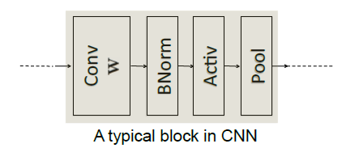
2 Binary Convolutional Neural Network
2.2 XNOR-Networks
2.2.3 Training XNOR-Networks
Batch Normalization：mean and variance
Activation：non-linear function(e.g.,Sigmoid, ReLU).
Pooling：applies any type of pooling (e.g.,max,min or average)

Slide 27
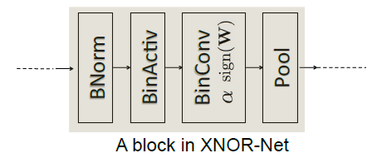
2 Binary Convolutional Neural Network
2.2 XNOR-Networks
Binary activation layer：computes K and sign(I)
BinConv：given K and sign(I)
Pool：pooling operations
It can insert a non-binary ctivation(e.g.,ReLU) after binary convolution.

Slide 28
1
Introduction and Related Work
2
Binary Convolutional Neural Network
3
Experiments
4
Conclusion

Slide 29
3 Experiments
efficiency
accuracy
Efficiency：computing the speedup
Accuracy：perform image classification on the large-scale ImageNet dataset.
The classification accuracy only 2.9% below the full precision version of AlexNet.
Compare with other method：BinaryConnect and BinaryNet
Out performs competitors by large margin

Slide 30

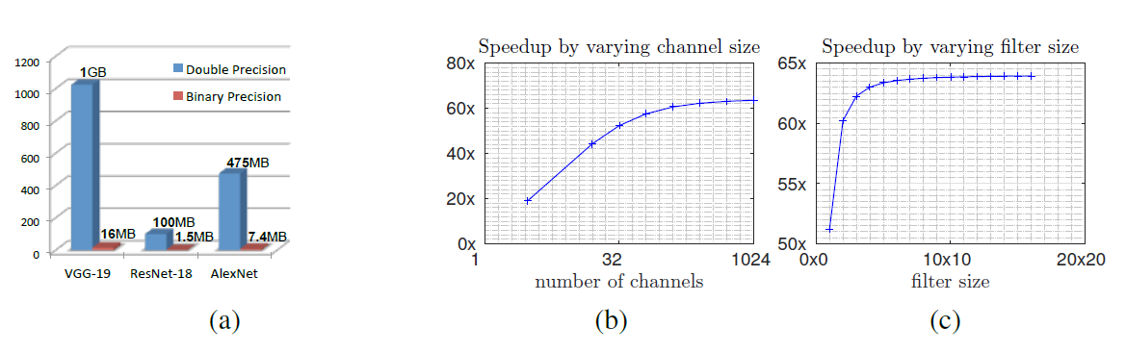

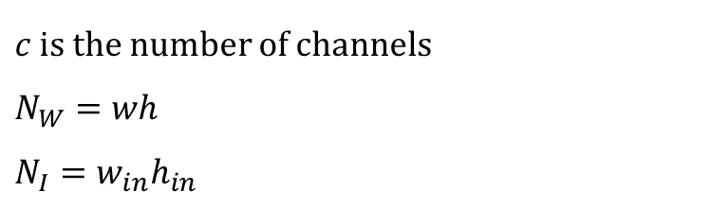
3 Experiments
3.1 Efficiency Analysis
is the total number of operations
$c$ is the number of channels
$$N_{W}=wh$$
$$N_{I}=w_{in}h_{in}$$
Speedup：
$$similar to ResNet :c=256，n_{I}={14}^{2}，n_{W}=3^{2}$$
They gain 62.27X theoretical speed up, and achieve 58X speed up in fact.

Slide 31
3 Experiments
3.2 Image Classification on ILSVRC2012
This article report their classification accuracies using Top-1 and Top-5 measures
base architectures for binarization:
AlexNet
Residual Networks (known as ResNet)
A variant of GoogleNet

Slide 32
3 Experiments
3.2 Image Classification on ILSVRC2012
3.2.1 AlexNet
A CNN architecture with 5 convolutional layers and two fully-connected layers.
They use AlexNet coupled with batch normalization layers.
Binary-weight-network(BWN)
VS
BinaryConnect(BC)[2]
XNOR-Networks(XNOR-Net)
VS
Binary Neural Net(BNN)
[2] Binarynet: Training deep neural networks with weights and activations constrained to +1 or -1.

Slide 33
3 Experiments
3.2 Image Classification on ILSVRC2012
3.2.1 AlexNet
Train：
First , resized to 256 pixel
Second , selected a random crop of 224x224
Run the training algorithm for 16 epochs with batch size equal to 512.
Use negative-log likelihood as their classification loss function.
Without Local-Response-Normalization(LRN)layer.
Use SGD with momentum=0.9 for updating parameters in BWN and BC.
For XNOR-Net and BNN, used ADAM.
Learning rate starts at 0.1 ,and apply a learning-rate-decay =0.01 every 4 epochs

Slide 34
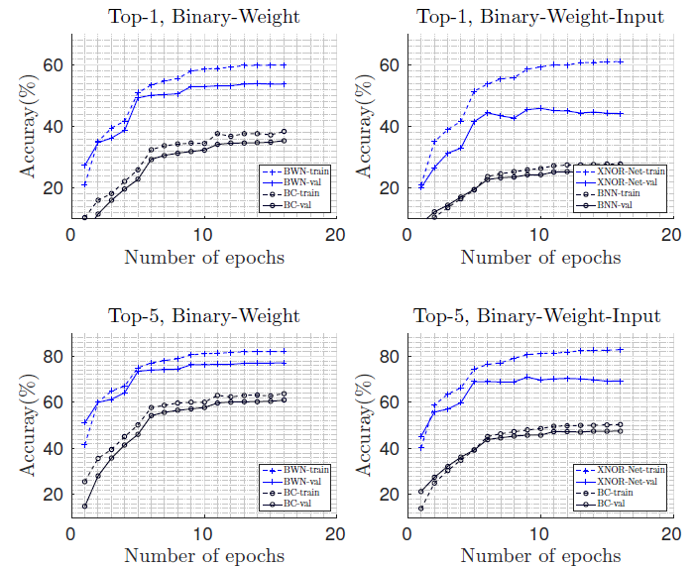
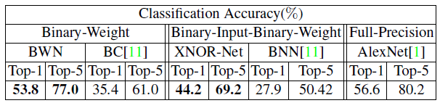
3 Experiments
3.2 Image Classification on ILSVRC2012
3.2.1 AlexNet
Test：

Slide 35
3 Experiments
3.2 Image Classification on ILSVRC2012
3.2.2 Residual Net
A large number of convolutional layers (varies from 18-151).
They use the ResNet-18, every two layers are connected by short-cut [4]
Train：
First , resized randomly between 256 and 480 pixel
Second , selected a random crop of 224x224
Run the training algorithm for 58 epochs with batch size equal to 256.
Learning rate starts at 0.1 ,and apply a learning-rate-decay =0.01 at epochs number 30 and 40.
[4] DEMYSTIFYING RESNET
.

Slide 36
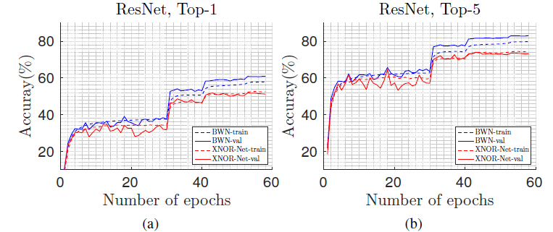
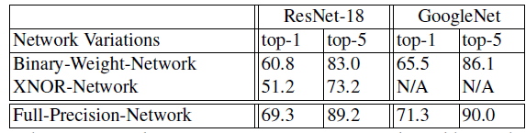
3 Experiments
3.2 Image Classification on ILSVRC2012
3.2.2 Residual Net

Slide 37
3 Experiments
3.2 Image Classification on ILSVRC2012
3.2.3 GoogleNet Variant
It uses a similar number of parameters and connections but only straightforward convolutions, no branching.
21 convolutional layers
filter sizes alternating between 1x1 and 3x3.
Train：
First , resized randomly between 256 and 320 pixel
Second , selected a random crop of 224x224
Run the training algorithm for 80 epochs with batch size equal to 128.
Learning rate starts at 0.1 ,and use polynomial rate decay, β=4.[3]
[3] Polynomial decay rate for the dissipative wave equation.

Slide 38
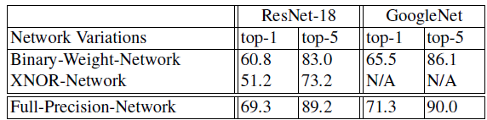
3 Experiments
3.2 Image Classification on ILSVRC2012
3.2.3 GoogleNet Variant

Slide 39
1
Introduction and Related Work
2
Binary Convolutional Neural Network
3
Experiments
4
Conclusion

Slide 40
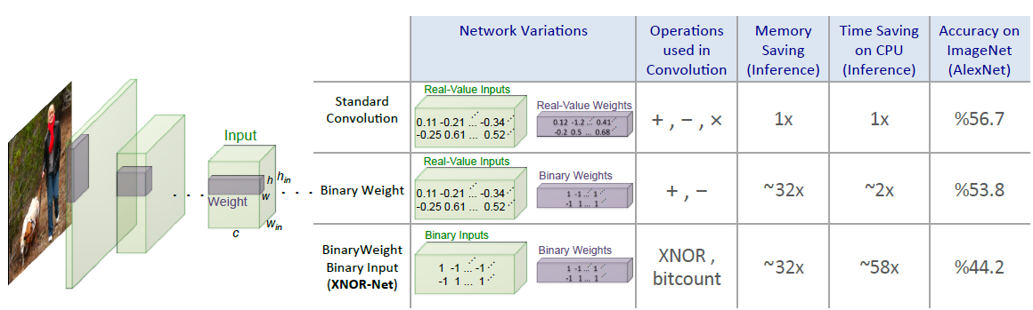
4 Conclusion
They find the optimal scaling factors at each iteration of training.
Order the layers in a block in a way that decreases the quantization loss.

Slide 41
Thanks！

